Slide 1
EULAR 2024 How to upload your presentations Poster Tour / Viewing Presentations

Slide 2
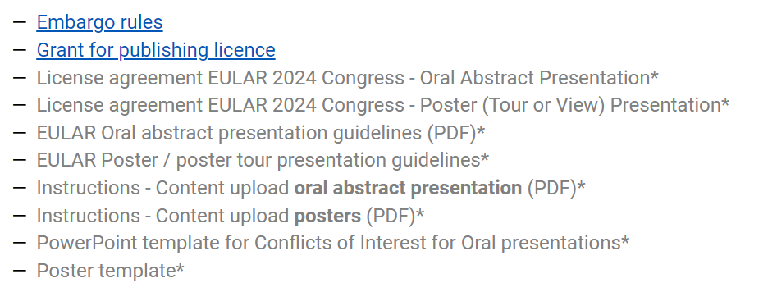
Step 1:
Download the powerpoint template
Go to: https://congress.eular.org/resources.cfm and download the powerpoint template

Slide 3
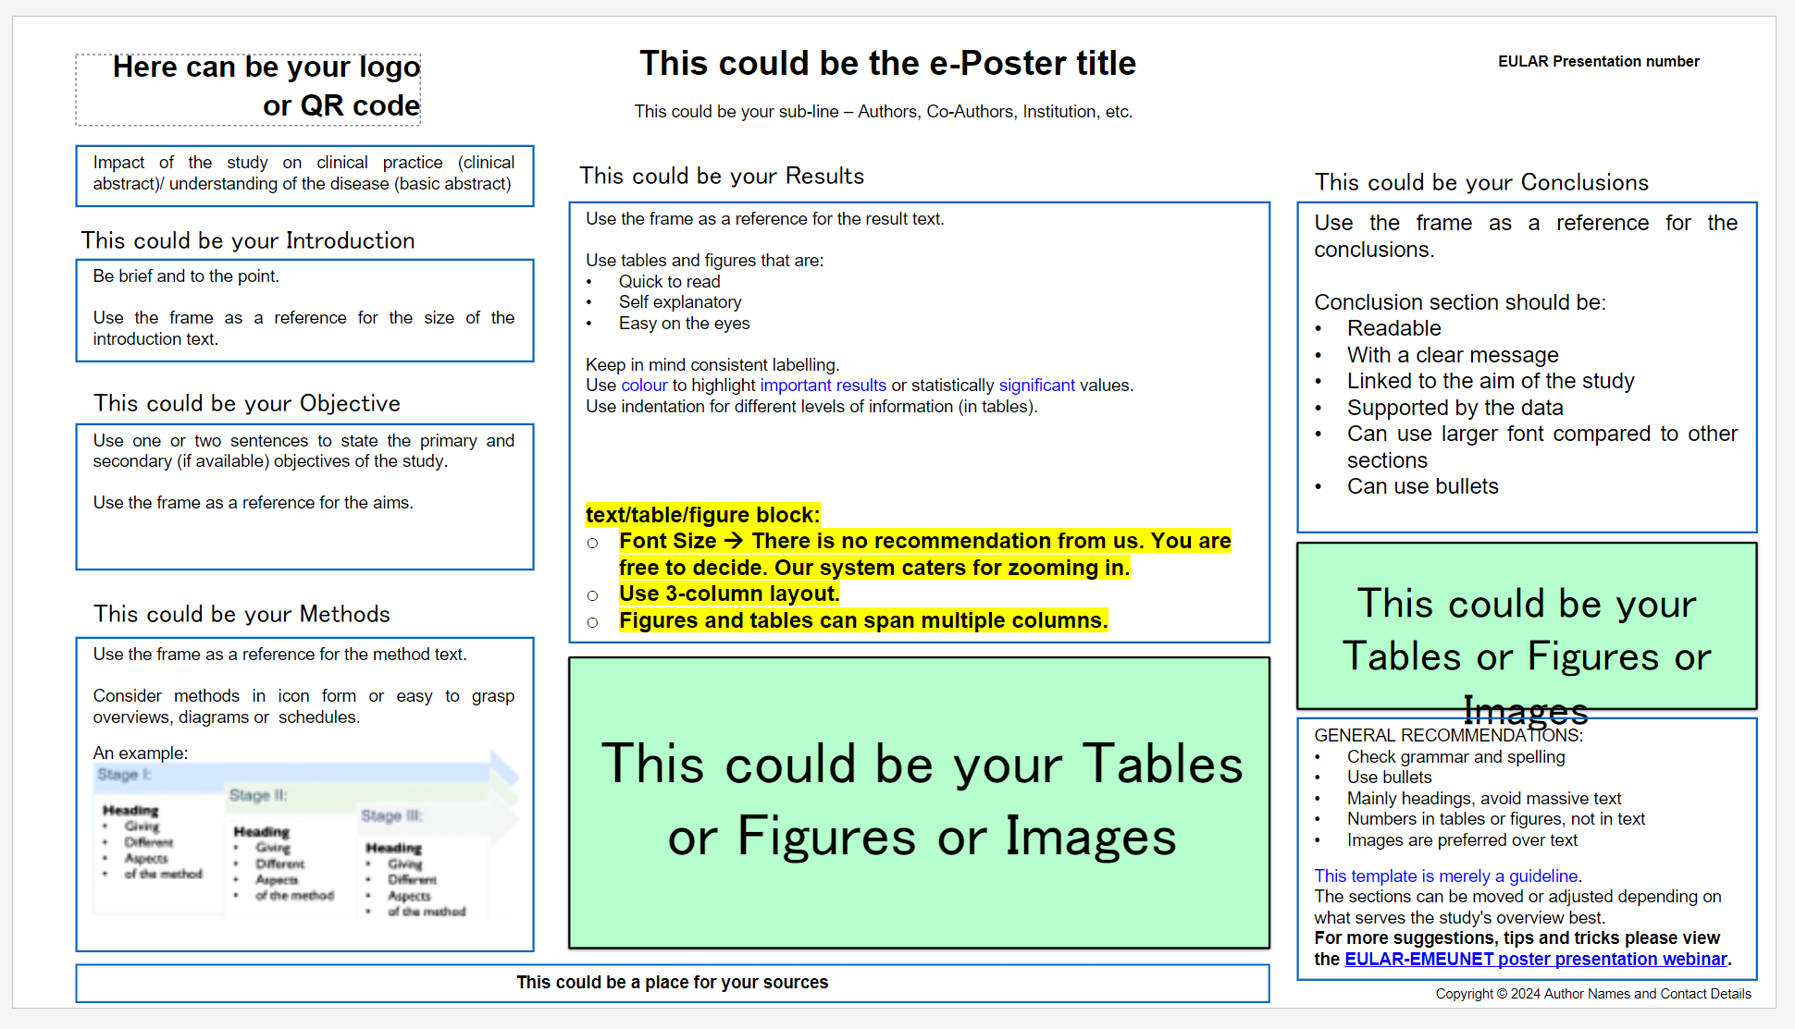
Step 2:
Add your presentation to the template

Slide 4
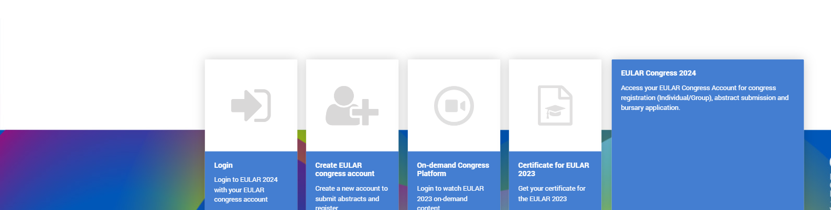
Link to log in to the Congress Platform: https://account-congress.eular.org/Home/Index/Account -
Step 3:
Log into your EULAR Congress account

Slide 5
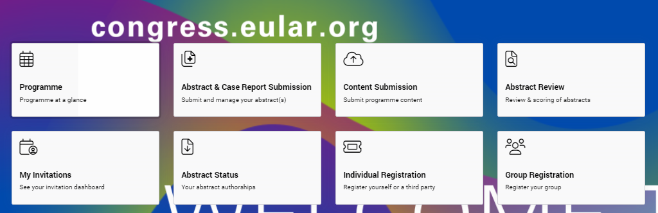
Step 4:
Upload content

Slide 6
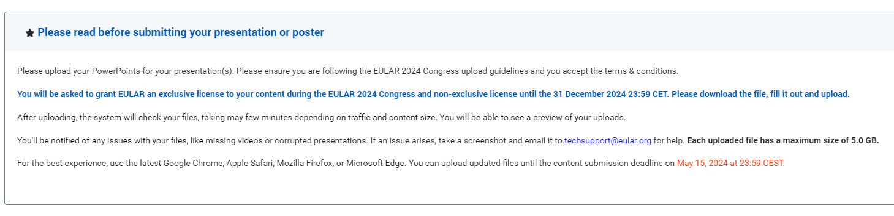
Step 5:
Read the guidelines

Slide 7
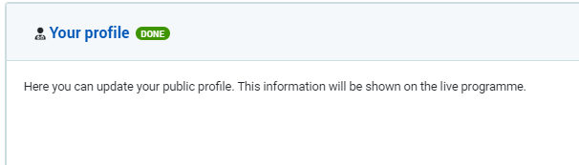
Step 6:
Update your profile
This will be visible on the public programme!!

Slide 8
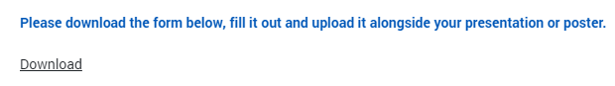

Step 7:
Accept webcasting policy
EULAR needs an exclusive license during the onsite congress (12-15 June 2024) and a non-exclusive license for the on-demand platform to your presentation, including slides, images, videos, voices etc.
^{1st Download the license}
2nd Tick the box to show you accept
For more information on the full EULAR Webcasting Policy, you can click on “Download” to read.

Slide 9
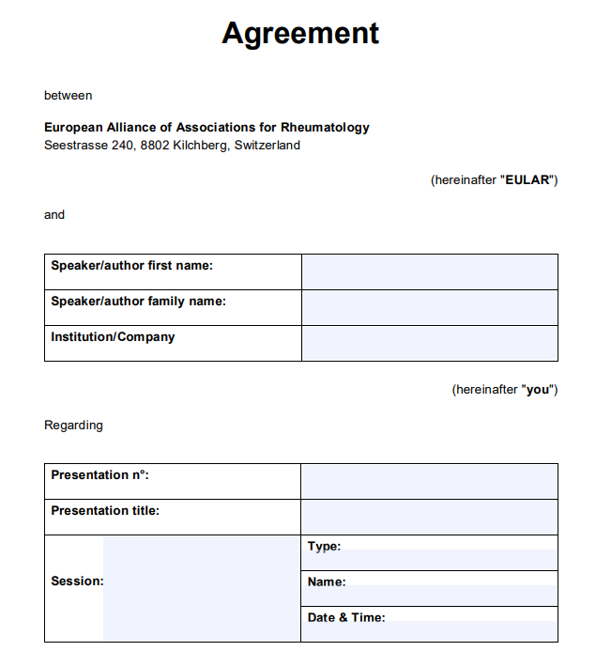
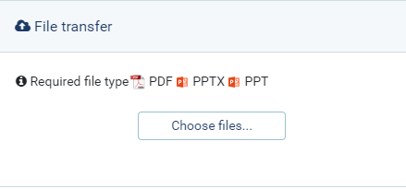

Step 8:
Fill in the form and upload
Click here to start your submission

Slide 10
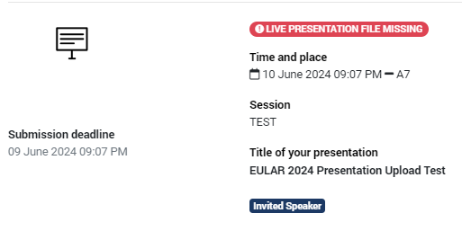
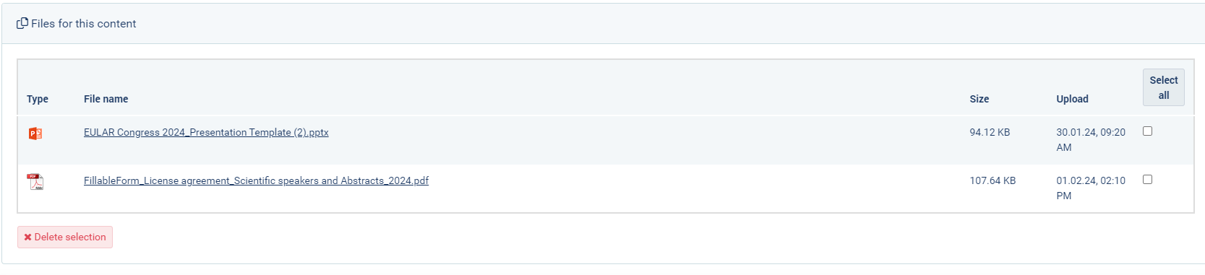
Step 9:
Upload your presentation
Here you can see your presentation details

Slide 11
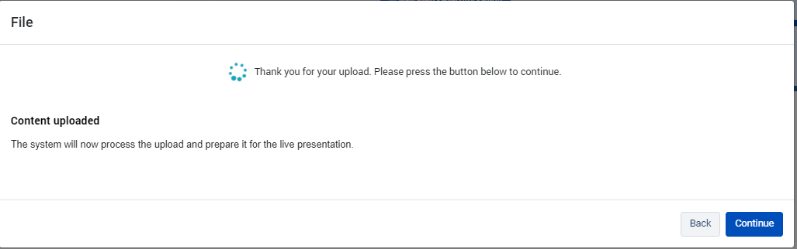
Step 10:
Wait for the upload
Upload time depends on file size

Slide 12
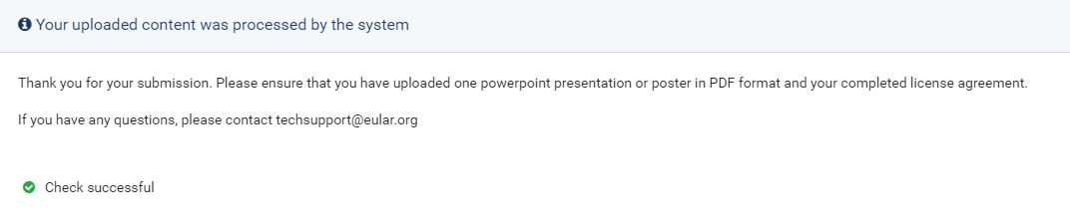
Step 10:
Confirm upload status

Slide 13
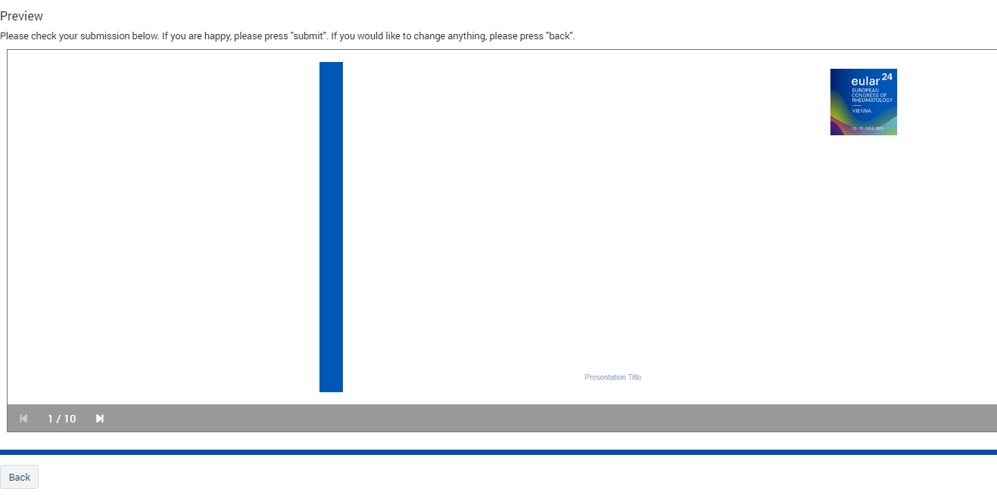
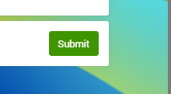
Step 11:
Check the preview
1. Click through to the preview page and proofread your presentation
2. If you’re happy, press submit!

Slide 14
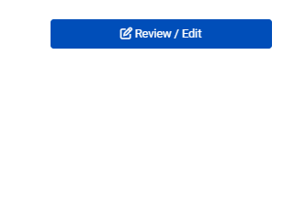
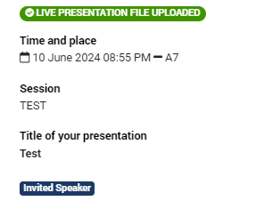
Finished!
You can always view, edit and reupload your presentation!
(until 24 hours before your presentation)

